Slide 1

Sensor Kit (Kit 1)
ZAS Robotics Training

Slide 2



Sensor Kit - Contents
Sensor Kit Components
Sensor Creative Board

Slide 3




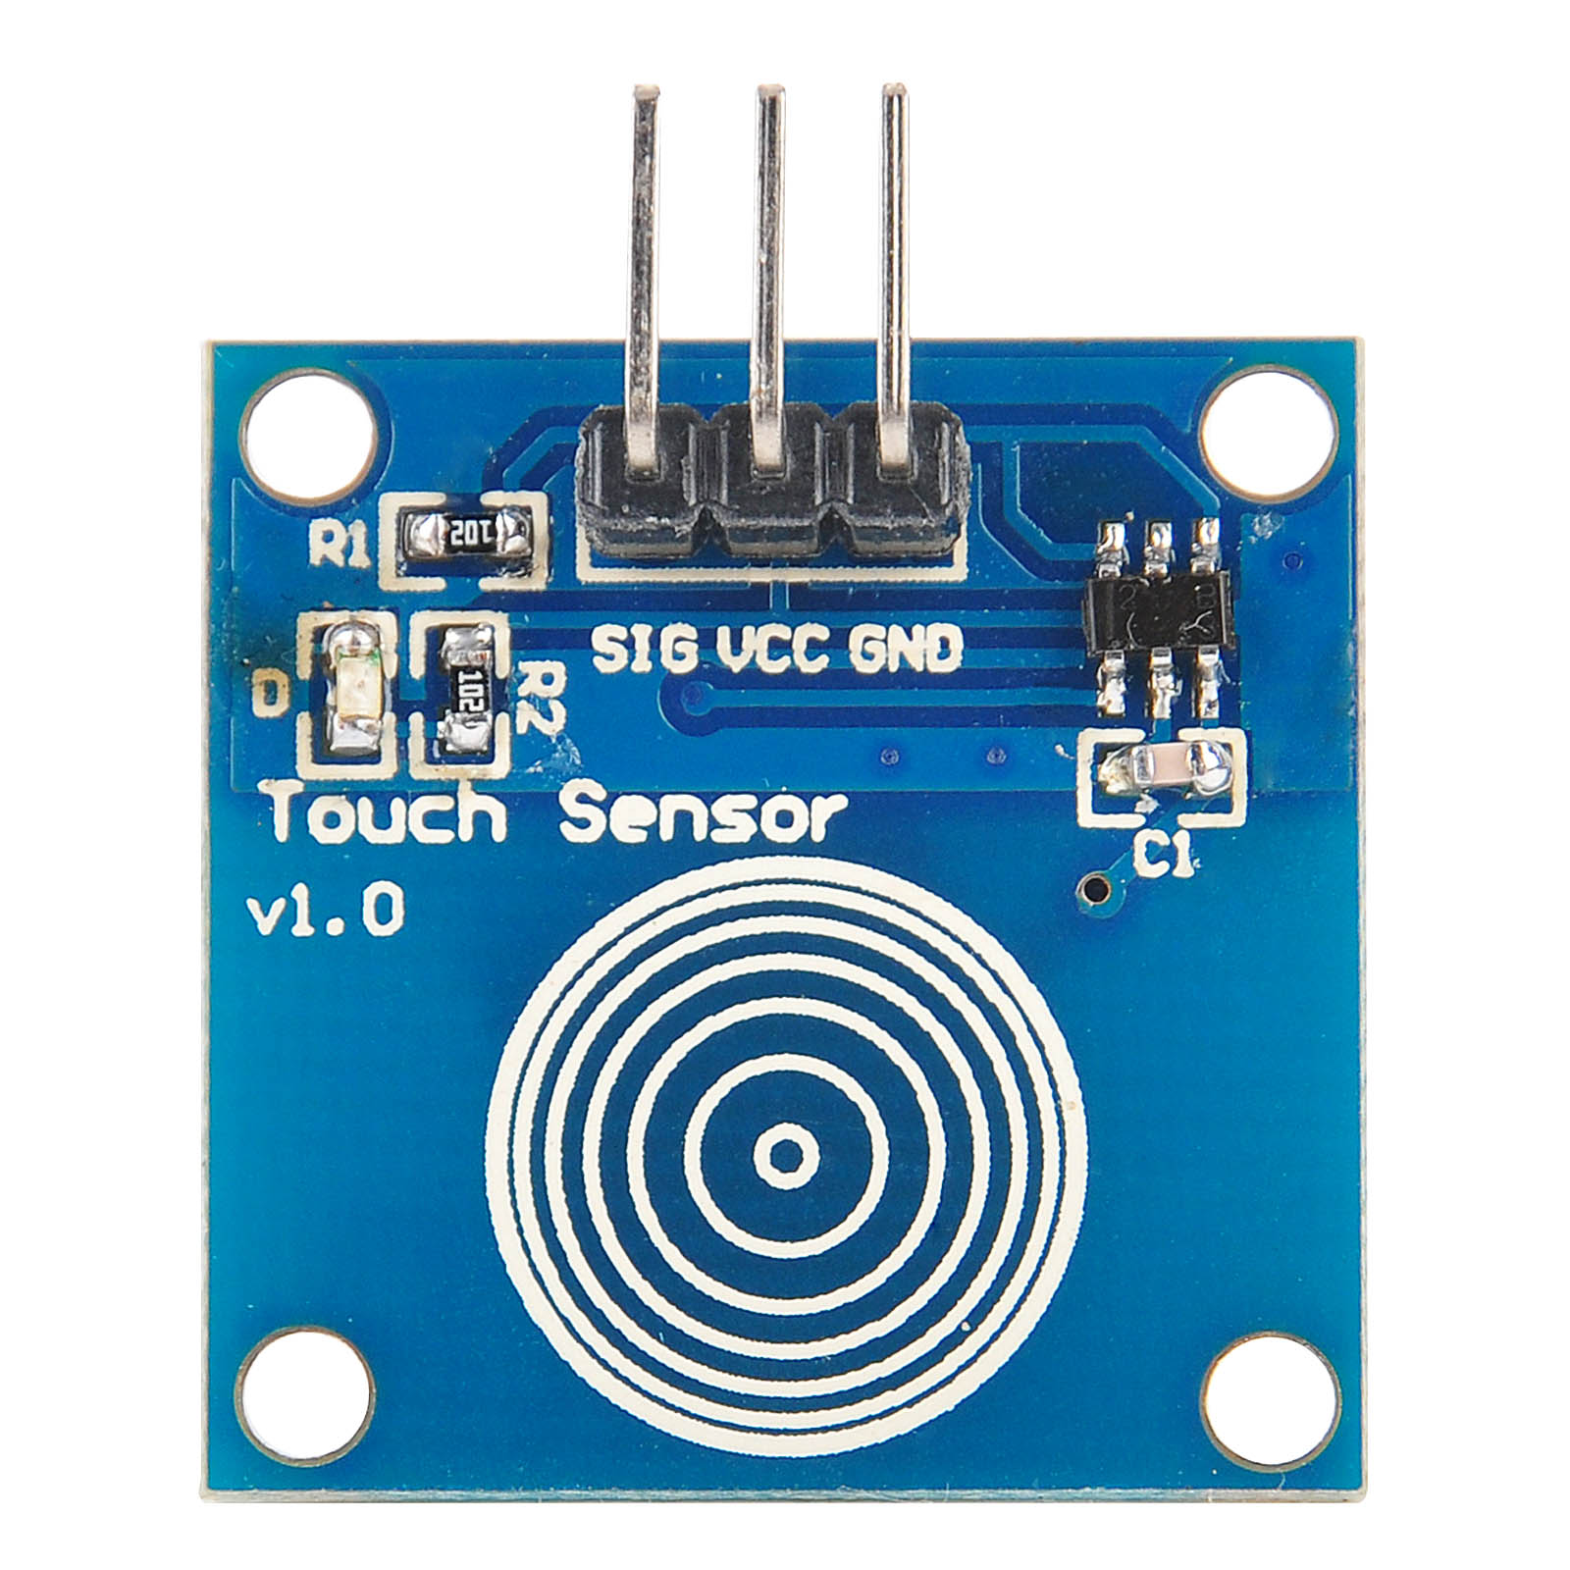
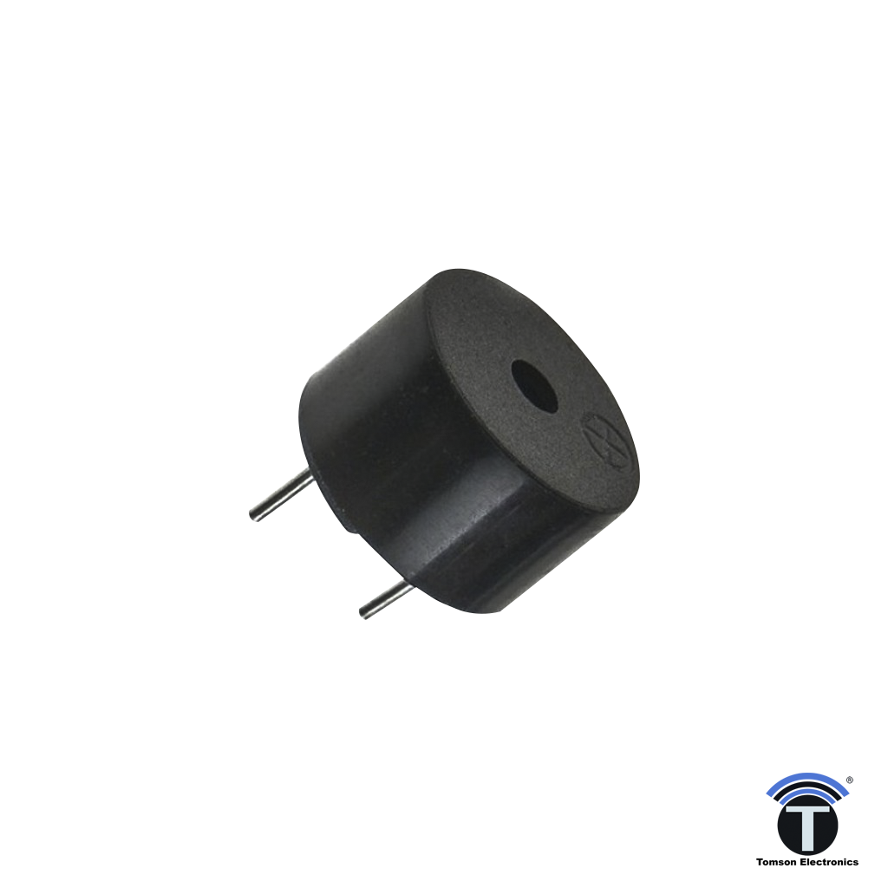
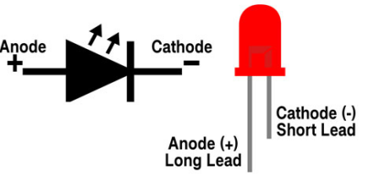
SFL05: TOUCH SENSOR WITH LED AND BUZZER
Things Needed

Slide 4
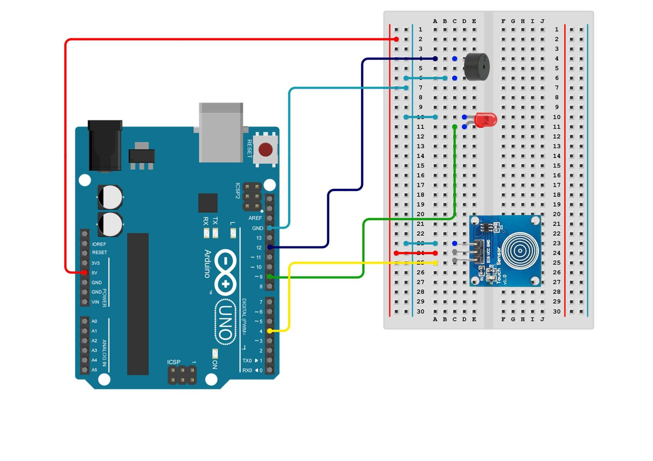
SFL05: TOUCH SENSOR WITH LED AND BUZZER
Circuit Diagram
Connections:
Arduino pins | Bread board
GND(common line from breadboard) | GND(all light blue lines )
5V | VCC (touch sensor-red line)
Pin 4 | SIG(touch sensor-yellow line)
Pin 12 | Positive (buzzer-violet line)
Pin 9 | LED(green line)

Slide 5
SFL05: TOUCH SENSOR WITH LED AND BUZZER
Define modules
Setup()
VCC to 5V
Common GND from all modules
pin 4 – touch sensor SIG
pin 12 – buzzer positive side
pin 9 – led long end
Loop()
If the touch sensor is activated, turn on the LED and buzzer
if not, turn OFF LED and buzzer.
Code for Lesson SFL05:
https://github.com/info-zas/zas-robotics-sensors/blob/main/01_FoundationProjects/01_Code/_05_TouchSensorActivated%20AlertswithLEDandBuzzer/_05_TouchSensorActivated%20AlertswithLEDandBuzzer.ino

Slide 6
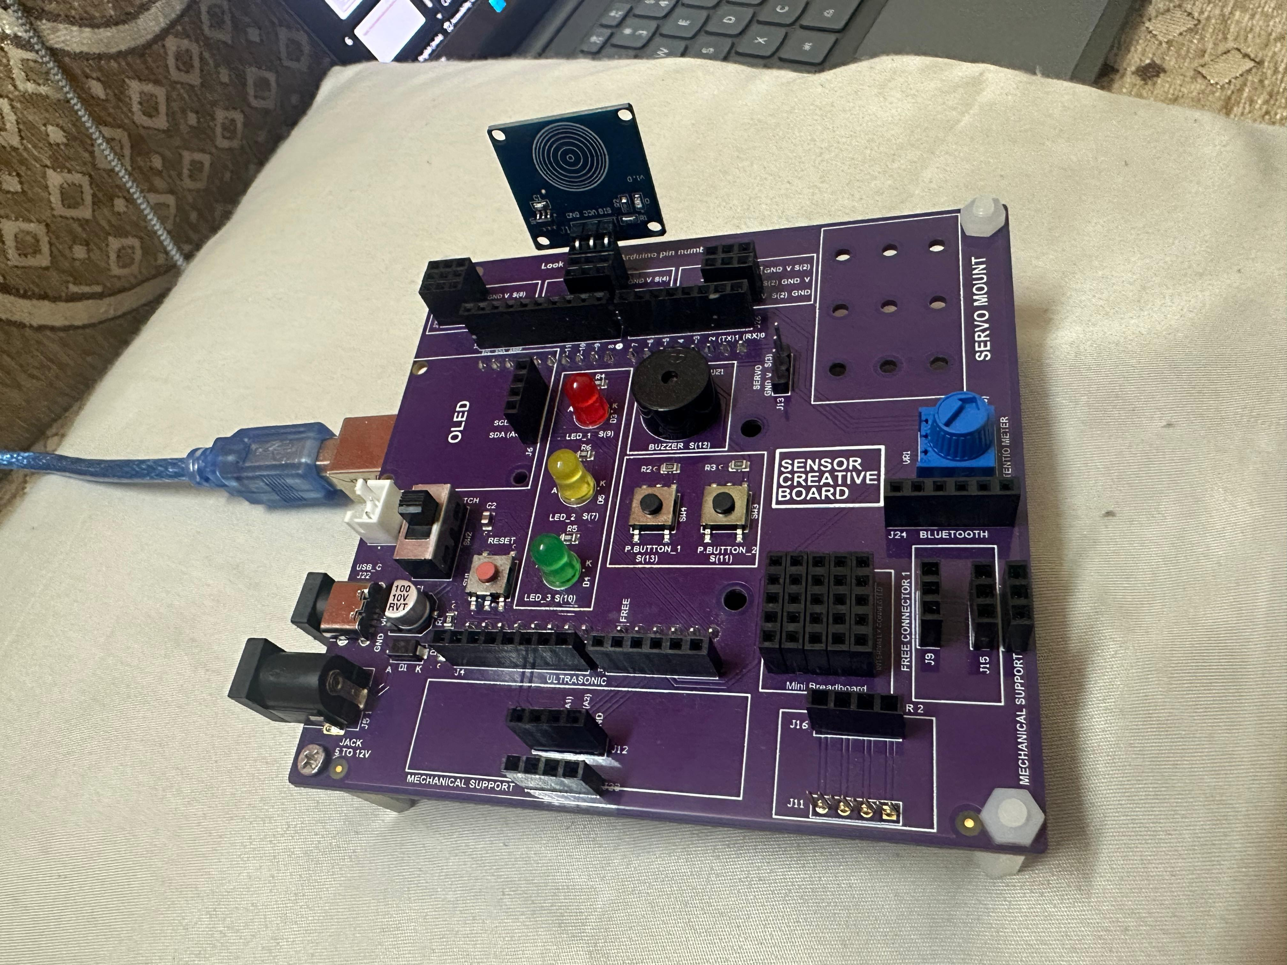
SFL05: TOUCH SENSOR WITH LED AND BUZZER
The board includes multiple 3-pin slots for connecting sensors.
Sensors plug in directly—no loose wires required.
All slots are internally connected to microcontroller pins.
Eliminates the need for breadboards and jumper wires.
Makes sensor testing and learning simple and organized.
Beginner-friendly design, ideal for students learning electronics.
Helps learners focus on concepts and coding, not complicated wiring.

